Slide 1
Specialized Flow Shops: Flexible Assembly Systems
ISE 419

Slide 2
Job Shops Flexible Assembly
Flow Shop Scheduling Limited Intermediate Storage Flexible Assembly
Each job has an unique identity
Make to order, low volume environment
Possibly complicated route through system
Very difficult
Limited number of product types
Given quantity of each type
Mass production
High degree of automation
Even more difficult!

Slide 3
Flow Shop Scheduling Limited Intermediate Storage Flexible Assembly
Flexible Manufacturing Systems (FMS)
Numerically Controlled machines
Automated Material Handling system
Produces a variety of product/part types
Scheduling
Routing of jobs
Sequencing on machines
Setup of tools
Similar features but more complicated

Slide 4
Flow Shop Scheduling Limited Intermediate Storage Flexible Assembly
Sequencing Unpaced Assembly Systems
Simple flow line with finite buffers
Application: assembly of copiers
Sequencing Paced Assembly Systems
Conveyor belt moves at a fixed speed
Application: automobile assembly
Scheduling Flexible Flow Systems
Flow lines with finite buffers and bypass
Application: producing printed circuit board

Slide 5
Flow Shop Scheduling Sequencing Unpaced Assembly Systems
Number of machines in series
No buffers
Material handling system
When a job finishes moves to next station
No bypassing
Blocking
Can model any finite buffer situation
Schedules often cyclic or periodic:
Given set of jobs scheduled in certain order
Contains all product types
May contain multiple jobs of same type
Second identical set scheduled, etc.
Insignificant setup time
Low inventory cost
Easy to implement

Slide 6
Minimum Part Set
Flow Shop Scheduling Sequencing Unpaced Assembly Systems
Suppose l product types
Let N_{k} be target number of jobs of type k
Let z be the greatest common divisor
Then
is the smallest set with ‘correct’ proportions
Example:
k | 1 | 2 | 3 | 4
N_{k} | 300 | 250 | 775 | 1000
N* | 300/25=12 | 250/25=10 | 775/25=31 | 1000/25=40

Slide 7
Defining a Cyclic Schedule
Flow Shop Scheduling Sequencing Unpaced Assembly Systems
Consider the jobs in the MPS as n jobs
A cyclic schedule is determined by sequencing the jobs in the MPS
Maximizing Throughput = Minimizing cycle time

Slide 8
Sequencing Example
Flow Shop Scheduling Sequencing Unpaced Assembly Systems
Master Production Schedule calls for 30,000 units in the month (30 days)
1000 per day
3 shifts
333 units per shift
420 minutes per shift (60 minutes maintenance and capacity buffer)
420/333 = 1.26 minutes per unit
Breakdown by product proportion
Product X = 20000 units (66 percent)
Product Y = 5000 units (17 percent)
Product Z = 5000 units (17 percent)

Slide 9
Flow Shop Scheduling Sequencing Unpaced Assembly Systems
Proportional Schedule
X X Y X X Z X X Y X X Z X X Y X X Z......
output rate - 1 unit each 1.26 minutes
X (1.26)(2) + 2.52(1) = 1.68 minutes
3
Y (1.26)(6) = 7.56 minutes
Z (1.26)(6) = 7.56 minutes

Slide 10
Uniform Plant Loading
Flow Shop Scheduling Sequencing Unpaced Assembly Systems

Slide 11
JIT Requires Fast Setups
Flow Shop Scheduling Sequencing Unpaced Assembly Systems
SMED Concepts
internal setup
external setup
Basic Steps to Setup Reduction
Identify all tasks as internal and external tasks
Convert as many tasks as possible to external
eliminate adjustments or reduce adjustment time
Eliminate the setup
standardize product requirements (engineering and manufacturing working together.)

Slide 12
Minimizing Cycle Time
Flow Shop Scheduling Sequencing Unpaced Assembly Systems
Profile Fitting (PF) heuristic:
Select first job j₁
Arbitrarily
Largest amount of processing
Generates profile
Determine which job goes next
PF heuristic performs well in practice
Basic assumptions
Setup is not important
Low WIP is important ⇒ Cyclic schedules good
departure times off the
succession of machines

Slide 13
Flow Shop Scheduling Limited Intermediate Storage Fm l block l C_{max}
If m_{i} finishes before m_{i+1}, job on m_{i} is blocked
Flow shop with finite intermediate storage equivalent to a flow shop with no intermediate storage
each storage space can be considered a “machine” with processing time of zero for all jobs
Fm l block l C_{max} assumes no intermediate storage
Job departure time calculations
D_{ij} = departure time of job j from m_{i} C_{ij}
D_{0j} = start time of job j on first machine
first job not blocked
current job off
last machine
previous job on
next machine
no blocking on last machine

Slide 14
PF: Next Job
Flow Shop Scheduling Sequencing Unpaced Assembly Systems
Compute for each candidate job
Time machines are idle
Time job is blocked
Start with departure times:

Slide 15
Nonproductive Time
Flow Shop Scheduling Sequencing Unpaced Assembly Systems
Calculate sum of idle and blocked time
Repeat for all remaining jobs
Select job with smallest number
Calculate new profile and repeat
Incorporating “bottleneckness” of machine
let
compare weighted sum of wasted time
to select next job k

Slide 16
Flow Shop Scheduling Sequencing Unpaced Assembly Systems
Example
Job 1 “profile” :
j | 1 | 2 | 3 | 4
p_{1,j} | 2 | 4 | 2 | 3
p_{2,j} | 4 | 4 | 0 | 2
p_{3,j} | 2 | 0 | 2 | 0
Σp_{i,j} | 8 | 8 | 4 | 5
jobs 1 and 2 offer most
load … pick job 1
D_{i,j} | [1]=1
i=1 | 2
i=2 | 6
i=3 | 8

Slide 17
Flow Shop Scheduling Sequencing Unpaced Assembly Systems
Assess candidate jobs for position [2]:
D_{i,j} | [1]=1 | c=2 | c=3 | c=4
i=1 | 2 | {2+4=6, 6}=6 | {2+2=4, 6}=6 | {2+3=5, 6}=6
i=2 | 6 | {6+4=10, 8}=10 | {6+0=6, 8}=8 | {6+2=8, 8}=8
i=3 | 8 | 10+0=10 | 8+2=10 | 8+0=8
I_{c} |  | 26-16-8=2 | 24-16-4=4 | 22-16-5=1
let [2]=4

Slide 18
Flow Shop Scheduling Sequencing Unpaced Assembly Systems
Assess candidate jobs for position [3]:
D_{i,j} | [2]=4 | c=2 | c=3
i=1 | 6 | {6+4=10, 8}=10 | {6+2=8, 8}=8
i=2 | 8 | {10+4=14, 8}=14 | {8+0=8, 8}=8
i=3 | 8 | 14+0=14 | 8+2=10
I_{c} |  | 38-22-8=8 | 26-22-4=0
S = 1-4-3-2
let [3]=3

Slide 19
Flow Shop Scheduling Sequencing Unpaced Assembly Systems
Assess delay for position [4]=2 :
D_{i,j} | [3]=3 | [4]=2
i=1 | 8 | {8+4=12, 8}=12
i=2 | 8 | {12+4=16, 10}=16
i=3 | 10 | 16+0=16
I_{c} |  | 44-26-8=10

Slide 20
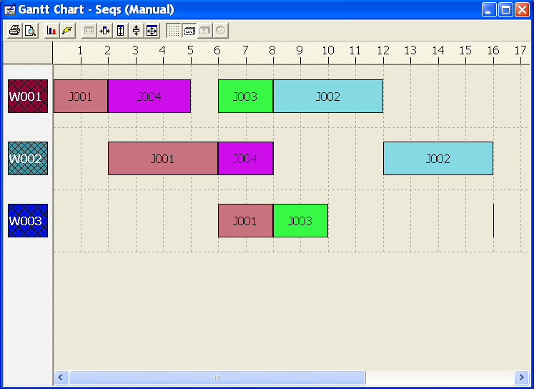
Flow Shop Scheduling Sequencing Unpaced Assembly Systems
Gantt chart of PF solution (first cycle)
cycle
end
profile

Slide 21
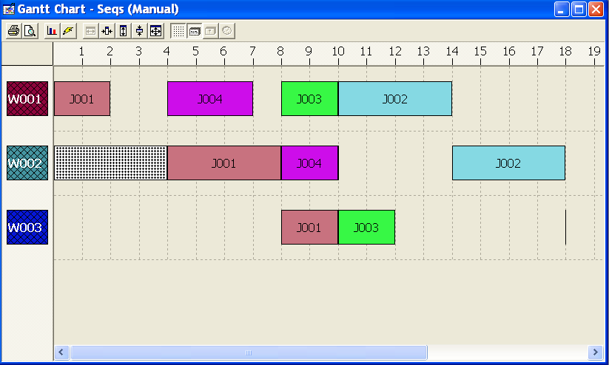
Flow Shop Scheduling Sequencing Unpaced Assembly Systems
S = 1-4-3-2 with machine 2 ready time = 4 :
Cycle time = 14

Slide 22
Paced Assembly Systems
Flow Shop Scheduling Limited Intermediate Storage Flexible Assembly
Conveyor moves jobs at fixed speeds
Fixed distance between jobs
Spacing proportional to processing time
No bypass
Unit cycle time
time between two successive jobs

Slide 23
Production Planning System in Nissan
Profit planning
Sales planning
Yearly production planning
Export planning
Actual sales Actual inventory
Transfer to new model Facility and worker Supplier capacity
Three-month production planning on a rolling basis (Master Schedule No 1)
Daily-divided production planning for the first month (Master Schedule No 2)
Ten-day order from dealers
Revised daily-divided production planning for the next 10 days (Master Schedule No 3)
Daily order from dealers
Revised daily production (Master Schedule No 4)
Sequence scheduling for the mixed model assembly line (“Actual schedule”)
Production of automobiles

Slide 24
Grouping and Spacing
Flow Shop Scheduling Paced Assembly Systems
Attributes and characteristics of each job
color, options, destination of cars
Changeover cost
Group operations with high changeover
Certain long operations
Space evenly over the sequence
Capacity constrained operations (criticality index)

Slide 25
Objectives
Flow Shop Scheduling Paced Assembly Systems
Minimize total setup cost
Meet due dates for make-to-order jobs
Total weighted tardiness
Spacing of capacity constrained operations
P_{i} (l) = penalty for working on two jobs l positions apart in i th workstation (penalty decreasing in l)
Regular (smooth) rate of material consumption

Slide 26
Grouping and Spacing Heuristic
Flow Shop Scheduling Paced Assembly Systems
Determine the total number of jobs to be scheduled
… higher number, more opportunity to lower scheduling costs
… lower number lowers disruptive effect of downtime
Group jobs with high setup cost operations
Order each subgroup accounting for shipping dates
Space jobs within subgroups accounting for capacity constrained operations

Slide 27
Example
Flow Shop Scheduling Paced Assembly Systems
Single machine with 10 jobs
Each job has a unit processing time
Two parameters
a_{k1} relates to setup groupings
a_{k2} relates to “capacity constrained” operations
Setup cost :
If there is a penalty cost

Slide 28
Example Data
Flow Shop Scheduling Paced Assembly Systems

Slide 29
Grouping
Flow Shop Scheduling Paced Assembly Systems
Group A: Jobs 1,2, and 3
Group B: Jobs 4,5, and 6
Group C: Jobs 7,8,9, and 10
Best order: A → B → C

Slide 30
Grouped Jobs
Flow Shop Scheduling Paced Assembly Systems
A B C
Due
date
⇒ Order A → C → B

Slide 31
Capacity Constrained Operations
Flow Shop Scheduling Paced Assembly Systems
A C B
Job
2
1
3
8
7
9
10
5
4
6
a
1
1
1
5
5
5
5
3
3
3
j1
a
1
0
1
0
1
0
0
1
0
1
j2
d
2
∞
∞
∞
6
∞
∞
∞
∞
∞
j
w
4
0
0
0
4
0
0
0
0
0
j

Slide 32

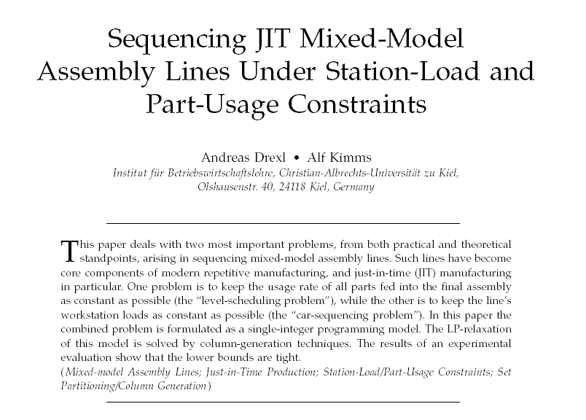
Flow Shop Scheduling Paced Assembly Systems

Slide 33
Flexible Flow System with Bypass
Flow Shop Scheduling Limited Intermediate Storage Flexible Assembly
There may be multiple machines at each station and/or there may be bypass

Slide 34
Flexible Flow Line Algorithm
Flow Shop Scheduling Flexible Flow System with Bypass
Objectives
Maximize throughput
Minimize work-in-process (WIP)
Minimizes the makespan of a day’s mix
Actually minimization of cycle time for MPS
Reduces blocking probabilities
Three phases:
Machine allocation phase
assigns each job to a specific machine at station
Sequencing phase
order in which jobs are released
dynamic balancing heuristic
Time release phase
minimize MPS cycle time on bottlenecks

Slide 35
Machine Allocation
Flow Shop Scheduling Flexible Flow System with Bypass
Bank of machines
Which machine for which job?
Basic idea: workload balancing
Use LPT dispatching rule
Sequencing
Dynamic balancing heuristic
Basic idea: spread out jobs sent to the same machine
For a given station, let p_{ij} be processing time of job j on i th machine
Let

Slide 36
Dynamic Balancing Heuristic
Flow Shop Scheduling Flexible Flow System with Bypass
Let S_{j} be the jobs released before and including job j
Define the fraction of total workload at machine i by the time job j enters
Target for all jobs in S_{j}

Slide 37
Minimizing Overload
Flow Shop Scheduling Flexible Flow System with Bypass
Define the overload of the i th machine
The cumulative overload is
Minimize
Target workload on machine i
Actual workload on machine i
Sum overloads

Slide 38
Release Timing
Flow Shop Scheduling Flexible Flow System with Bypass
MPS workload of each machine known
Highest workload = bottleneck
MPS cycle time ≥ Bottleneck cycle time
Algorithm
Step 1: Release all jobs as soon as possible
Step 2: Delay all jobs upstream from bottleneck as much as possible
Step 3: Move along all jobs downstream from the bottleneck as much as possible

Slide 39
Example
Flow Shop Scheduling Flexible Flow System with Bypass

Slide 40
Data
Flow Shop Scheduling Flexible Flow System with Bypass

Slide 41
Machine Allocation: LPT assignment to machines at a stage
Flow Shop Scheduling Flexible Flow System with Bypass

Slide 42
Workload
Flow Shop Scheduling Flexible Flow System with Bypass

Slide 43
Calculate Target Workload
Flow Shop Scheduling Flexible Flow System with Bypass
Jobs | 1 | 2 | 3 | 4 | 5 | W_{i}
p_{1j} | 6 | 0 | 0 | 3 | 0 | 9
p_{2j} | 0 | 3 | 1 | 0 | 5 | 9
p_{3j} | 3 | 2 | 1 | 3 | 2 | 11
p_{4j} | 4 | 5 | 0 | 3 | 0 | 12
p_{5j} | 0 | 0 | 6 | 0 | 4 | 10
 | 0.255 | 0.196 | 0.157 | 0.176 | 0.216
W = 51
13/51
10/51
8/51
9/51
11/51

Slide 44
Flow Shop Scheduling Flexible Flow System with Bypass
Overload Matrix
Jobs | 1 | 2 | 3 | 4 | 5 | W_{i}
p_{1j} | 6 | 0 | 0 | 3 | 0 | 9
p_{2j} | 0 | 3 | 1 | 0 | 5 | 9
p_{3j} | 3 | 2 | 1 | 3 | 2 | 11
p_{4j} | 4 | 5 | 0 | 3 | 0 | 12
p_{5j} | 0 | 0 | 6 | 0 | 4 | 10
 | 0.255 | 0.196 | 0.157 | 0.176 | 0.216
W = 51
O₁₁ = 6 – 0.255 * 9 = 3.71

Slide 45
Flow Shop Scheduling Flexible Flow System with Bypass
Overload Matrix
Jobs | 1 | 2 | 3 | 4 | 5 | W_{i}
p_{1j} | 6 | 0 | 0 | 3 | 0 | 9
p_{2j} | 0 | 3 | 1 | 0 | 5 | 9
p_{3j} | 3 | 2 | 1 | 3 | 2 | 11
p_{4j} | 4 | 5 | 0 | 3 | 0 | 12
p_{5j} | 0 | 0 | 6 | 0 | 4 | 10
 | 0.255 | 0.196 | 0.157 | 0.176 | 0.216
W = 51
O₁₁ = 6 – 0.25 * 9 = 3.75
O₃₂ = 2 – 0.196 * 11 = -0.16

Slide 46
Overload: job contribution to each as the first job in sequence
Flow Shop Scheduling Flexible Flow System with Bypass

Slide 47
Flow Shop Scheduling Flexible Flow System with Bypass
Overload Matrix
Jobs | 1 | 2 | 3 | 4 | 5 | W_{i}
O_{1j} | 3.71 | -1.76 | -1.41 | 1.41 | -1.94 | 9
O_{2j} | -2.29 | 1.24 | -0.41 | -1.59 | 3.06 | 9
O_{3j} | 0.20 | -0.16 | -0.73 | 1.06 | -0.37 | 11
O_{4j} | 0.94 | 2.65 | -1.88 | 0.88 | -2.59 | 12
O_{5j} | -2.55 | -1.96 | 4.43 | -1.76 | 1.84 | 10
 | 0.255 | 0.196 | 0.157 | 0.176 | 0.216
W = 51

Slide 48
Dynamic Balancing
Flow Shop Scheduling Flexible Flow System with Bypass
First Job

Slide 49
Calculate Target Workload
Flow Shop Scheduling Flexible Flow System with Bypass
Jobs | 1 | 2 | 3 | 4 | 5 | W_{i}
p_{1j} | 6 | 0 | 0 | 3 | 0 | 9
p_{2j} | 0 | 3 | 1 | 0 | 5 | 9
p_{3j} | 3 | 2 | 1 | 3 | 2 | 11
p_{4j} | 4 | 5 | 0 | 3 | 0 | 12
p_{5j} | 0 | 0 | 6 | 0 | 4 | 10
W = 51
Since job 4 goes, the meaning of each cell changes: total load up to (and including) job j
Consider the cumulative load
on m1 if we choose job 1 next

Slide 50
Selecting the Second Job
Flow Shop Scheduling Flexible Flow System with Bypass
Calculate the cumulative overload
where

Slide 51
Calculate Target Workload
Flow Shop Scheduling Flexible Flow System with Bypass
Jobs | 1 | 2 | 3 | 4 | 5 | W_{i}
p_{1j} | 9 | 3 | 3 | 3 | 3 | 9
p_{2j} | 0 | 3 | 1 | 0 | 5 | 9
p_{3j} | 6 | 5 | 4 | 3 | 5 | 11
p_{4j} | 7 | 8 | 3 | 3 | 3 | 12
p_{5j} | 0 | 0 | 6 | 0 | 4 | 10
 | 0.43 | 0.37 | 0.33 |  | 0.39
W = 51
22/51
19/51
17/51
20/51

Slide 52
Cumulative Overload
Flow Shop Scheduling Flexible Flow System with Bypass
Jobs | 1 | 2 | 3 | 4 | 5 | W_{i}
O_{1j} | 5.13 | -0.33 | 0 | 3 | -0.51 | 9
O_{2j} | -3.87 | -0.33 | 2 | 0 | 1.49 | 9
O_{3j} | 1.27 | 0.93 | 0.37 | 3 | 0.71 | 11
O_{4j} | 1.84 | 3.56 | -1 | 3 | -1.68 | 12
O_{5j} | -4.3 | -3.7 | 2.67 | 0 | 0.1 | 10
 | 0.43 | 0.37 | 0.33 |  | 0.39
 | 8.67 | 4.86 | 5.37 |  | 2.69
W = 51
Job 5 goes next

Slide 53
Final Cycle
Flow Shop Scheduling Flexible Flow System with Bypass
Schedule jobs 4,5,1,3,2
Release timing phase
Machine 4 is the bottleneck
Delay jobs on Machine 1, 2, and 3
Expedite jobs on Machine 5

Slide 54
Flow Shop Scheduling Mixed Model Assembly Sequencing at Toyota
Everything operates on Just-in-Time
Works to minimize WIP & tardiness
To do this, the most important objective is to keep the part consumption regular
The quantity of a given part consumed per hour should be constant
Solution: the next car to build is chosen to minimize error from the desired rate

Slide 55
Production Planning System in Toyota
Production promptly adaptable to demand changes
“Just-in-time” production (produce the saleable products in saleable quantities)
Monthly adaption: production responding to the sales velocity (cycle time) of total quantity
Daily adaption: production responding to the sales velocity of each model
Monthly capacity planning of each process
Daily production dispatching according to each model’s cycle time
Predetermined production quantities and the daily average production quantity of each model to each process
Dispatching the actual production quantity of each product daily to a preceding process by Kanban system (pull system)
Master production schedules: determination of the monthly production plan for each model of car
Determination of the sequence for the mixed model assembly line
Monthly demand forecast
Daily orders from the dealers
Production smoothing
Flexible machinery
Reduction of the production lead time

Slide 56
Example
Flow Shop Scheduling Mixed Model Assembly Sequencing at Toyota
Model 1 requires 1 grommit
Model 2 requires 2 grommits
Model 3 requires 3 grommits
We will produce:
10 cars of model 1
15 cars of model 2
10 cars of model 3

Slide 57
Flow Shop Scheduling Mixed Model Assembly Sequencing at Toyota
So we need
(10 * 1) + (15 * 2) + (10 * 3) = 70
If the consumption of grommits is to be constant, we need to consume 70/35 = 2 per car
Choose car [k] to minimize:
(Grommits use/cars built – 2)²
Toyota tracks about 20 “parts” (subassemblies)
Minimizes the sum of squared error over all these parts

Slide 58
Flow Shop Scheduling Mixed Model Assembly Sequencing at Toyota
“Rate-based” schedule
Keep rate of part consumption as regular as possible
Definitions:
N = total number of assemblies required
t = total number of assembly types
N_{j} = total number of assembly j required
m = total number of part types required for N assemblies
b_{i,j} = number of part i needed for each assembly j
R_{i} = total number of part i required for N assemblies
x_{i,k} = total number of part i required for first k assemblies in sequence

Slide 59
Flow Shop Scheduling Mixed Model Assembly Sequencing at Toyota
Smoothing part consumption is achieved through position k in assembly sequence by minimizing:
If assembly j is being considered for position k , define
goal
actual

Slide 60
Flow Shop Scheduling Mixed Model Assembly Sequencing at Toyota
Goal-Chasing Algorithm

